Slide 1
Presented by:-
Anuja Shirsath
Mohini Chaudhari
Ashwini Jadhav
Mehul Dudhane
Kiran Jaybhay
BIG TABLE

Slide 2
Big Table Google Big Table is a columnar database and good for sparse data. Google Big Table contains row key, column key and time stamps. Each table has only one index, row key. Cloud Bigtable is a sparsely populated table that can scale to billions of rows and thousands of columns, enabling you to store terabytes or even petabytes of data. A single value in each row is indexed; this value is known as the row key. Cloud Bigtable is ideal for storing very large amounts of single-keyed data with very low latency. It supports high read and write throughput at low latency, and it is an ideal data source for MapReduce operations. Cloud Bigtable is exposed to applications through multiple client libraries, including a supported extension to the Apache HBase library for Java.

Slide 3
Advantages Cloud Bigtable's powerful back-end servers offer several key advantages over a self-managed HBase installation: Incredible scalability. Cloud Bigtable scales in direct proportion to the number of machines in your cluster. A self-managed HBase installation has a design bottleneck that limits the performance after a certain threshold is reached. Simple administration. Cloud Bigtable handles upgrades and restarts transparently, and it automatically maintains high data durability. To replicate your data, simply add a second cluster to your instance, and replication starts automatically. No more managing replicas or regions; just design your table schemas, and Cloud Bigtable will handle the rest for you. Cluster resizing without downtime. You can increase the size of a Cloud Bigtable cluster for a few hours to handle a large load, then reduce the cluster's size again—all without any downtime. After you change a cluster's size, it typically takes just a few minutes under load for Cloud Bigtable to balance performance across all of the nodes in your cluster.

Slide 4
Applications We can use Cloud Bigtable to store and query all of the following types of data: Time-series data: such as CPU and memory usage over time for multiple servers. Marketing data, such as purchase histories and customer preferences. Financial data: such as transaction histories, stock prices, and currency exchange rates. Internet of Things data: such as usage reports from energy meters and home appliances. Graph data: such as information about how users are connected to one another.

Slide 5
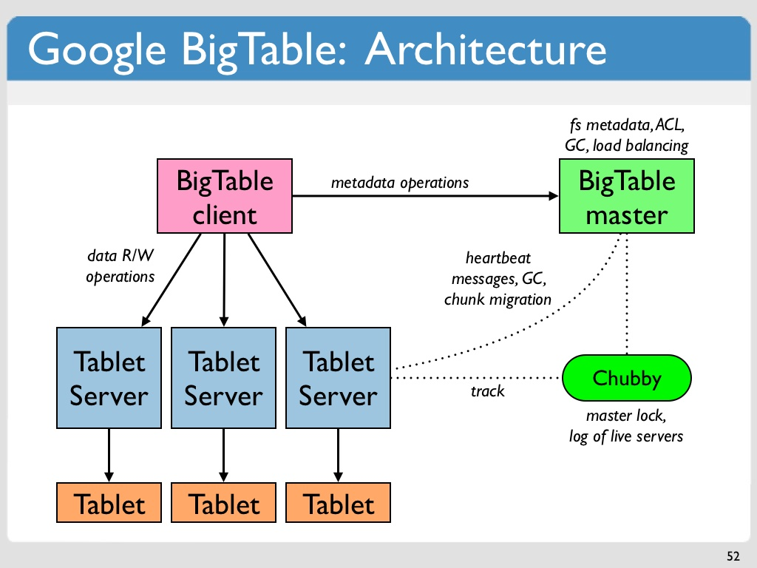

Slide 6
Bigtable Architecture As the diagram illustrates, all client requests go through a front-end server before they are sent to a Cloud Bigtable node. The nodes are organized into a Cloud Bigtable cluster, which belongs to a Cloud Bigtable instance, a container for the cluster. Each node in the cluster handles a subset of the requests to the cluster. By adding nodes to a cluster, you can increase the number of simultaneous requests that the cluster can handle, as well as the maximum throughput for the entire cluster. If you enable replication by adding a second cluster, you can also send different types of traffic to different clusters, and you can fail over to one cluster if the other cluster becomes unavailable. A Cloud Bigtable table is sharded into blocks of contiguous rows, called tablets, to help balance the workload of queries. (Tablets are similar to HBase regions.) Tablets are stored on Colossus, Google's file system, in SSTable format. An SSTable provides a persistent, ordered immutable map from keys to values, where both keys and values are arbitrary byte strings.

